Slide 1
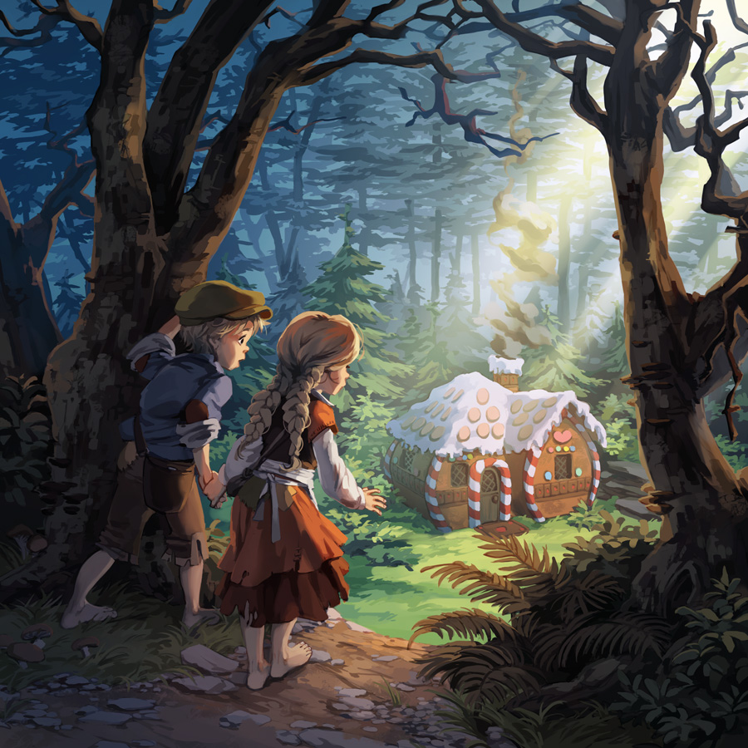
Hansel & gretel :
Witch’s story
Game from krekre group

Slide 2

Game Concept
Genre: 2D adventure, storytelling
Plot: Reference by Hansel and Gretel( Grimms’ Fairy Tales). We will use Hansel & Gretal basic story as an introduction. Then, the main story will be part of why the witch become a bad guy.

Slide 3
What are you trying to achieve with the game?
To entertain players and present old storytelling in another view.
Find a way to use our creativity as much benefit as possible.

Slide 4
What would the game be like and who would play it?
This game will be a 2D adventure game and have some stories.
Our target group is teenagers and Grimm’s fan club.

Slide 5
How such people playing your game and such game you are making would get you what you want to achieve in the first place?
Gameplay: to get through the state and to know a story, players need to complete a task from each other state. This game will look like Typoman. For example, you have to pass through obstacles to collect the ingredients to bake a bread.
People playing: Anyone is okay because even if you don’t know Hansel & Gretel story we will tell you in the game.

Slide 6
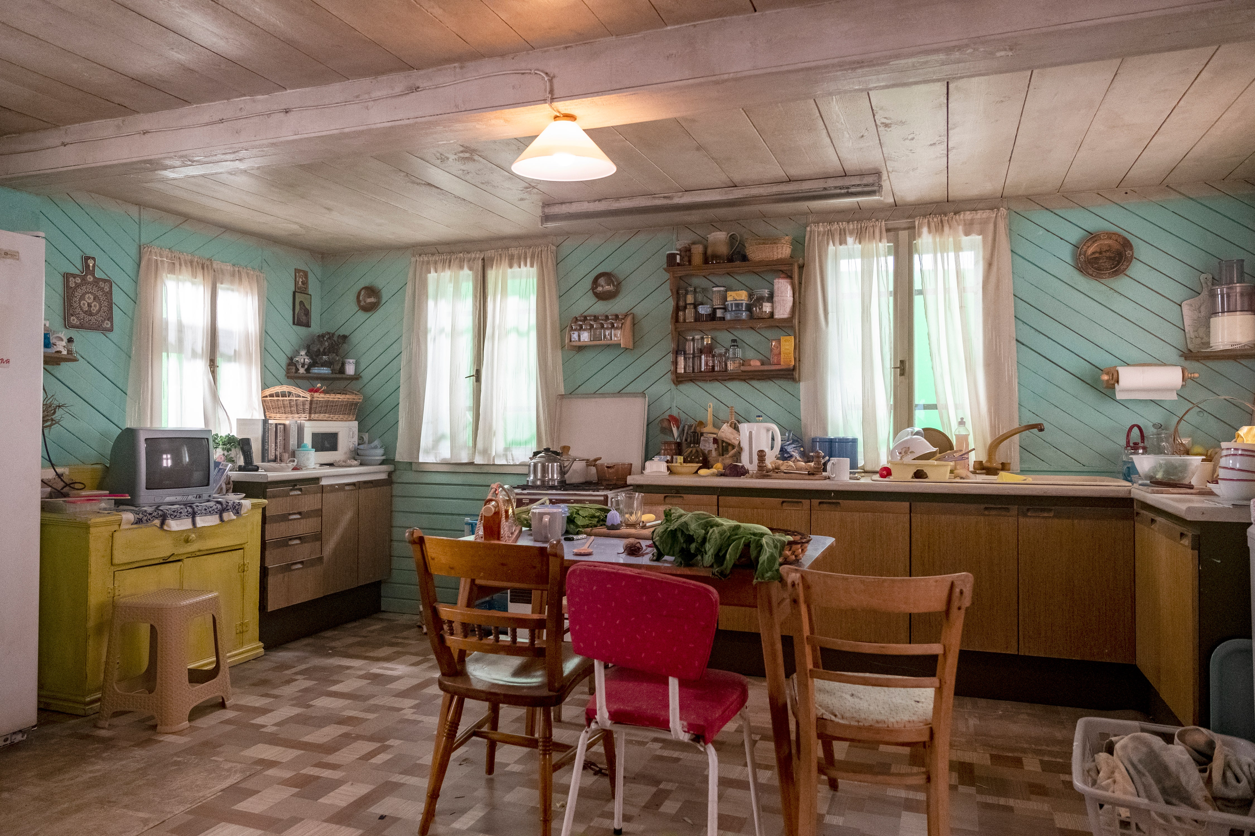
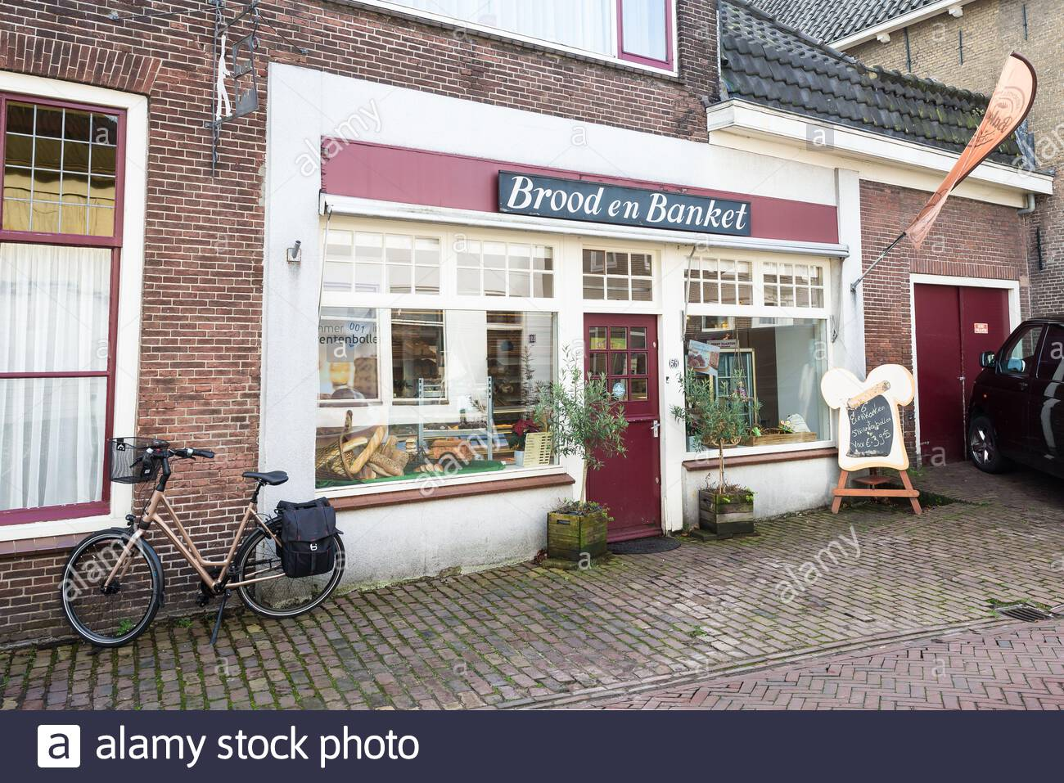
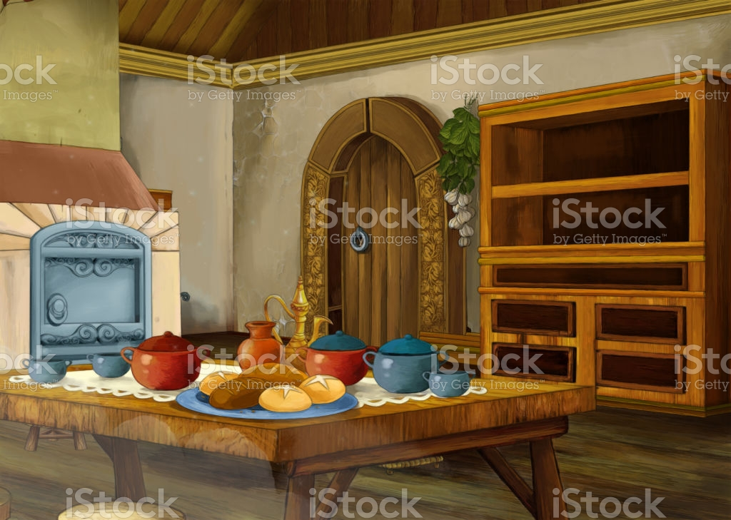
Scene

Slide 7
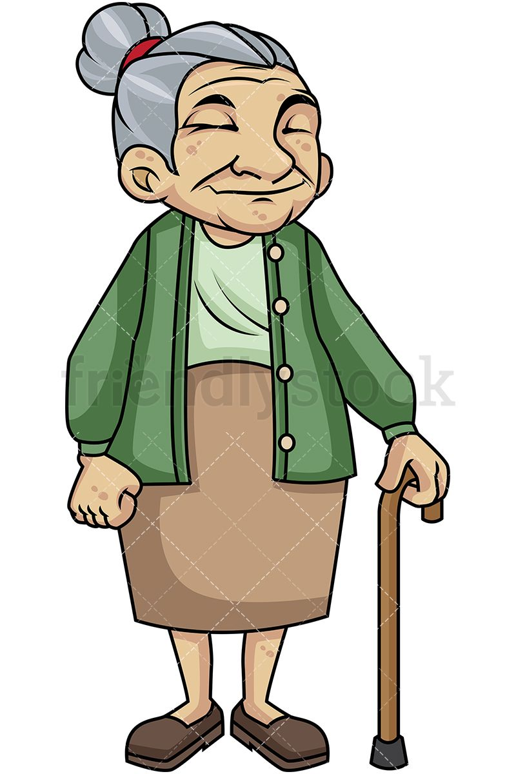

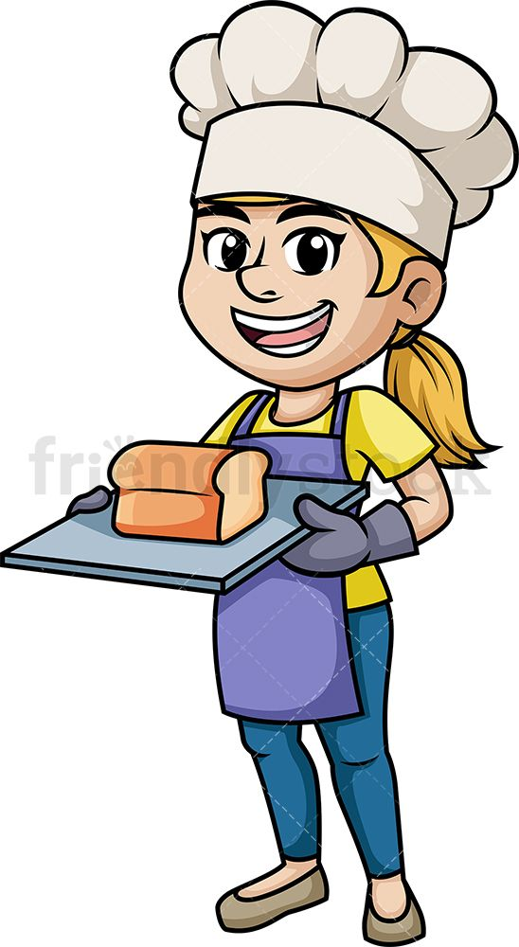
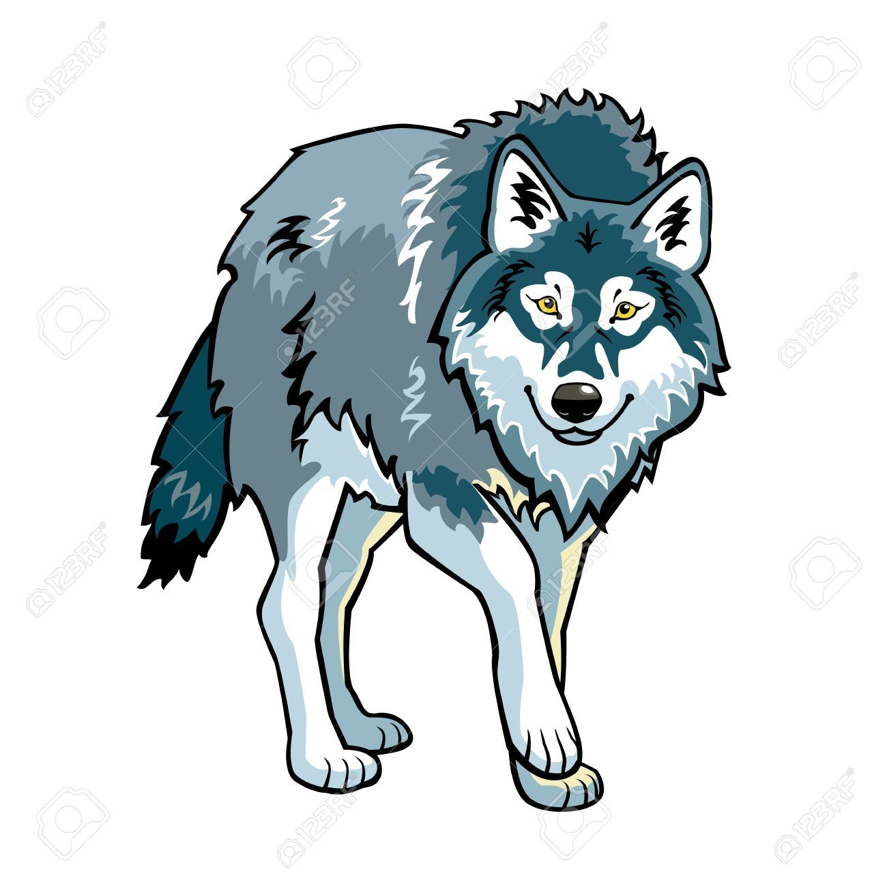
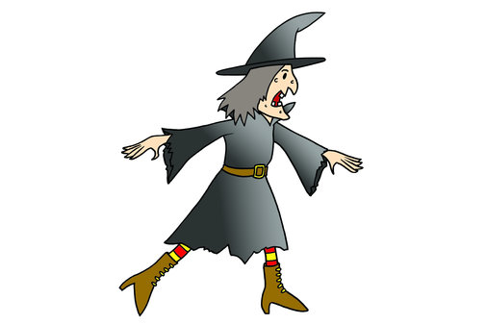

Characters
Main: woman before becoming a witch, witch
NPC: Old women
Enemy: children, wolf, snake,

